Slide 1
Module 39: Introducing Siebel Workflow
Siebel Core Developer and Technology School
Notes:
Time: Lecture: 45 minutes; labs: 35 – 45 minutes
Intent: To describe Siebel Workflow and the business reasons for using Siebel Workflow.
Flow: This module has two main purposes: first to define Siebel Workflow, then to introduce students to workflow steps and how to build a workflow process. The module begins by describing the relationship between business processes and workflow processes. Next, it explains the workflow design canvas; describes workflow steps while building a simple workflow process; demonstrates how context-sensitive menus are used; shows how to create condition criteria for a decision step; and provides details for additional workflow steps.
Key Terms:
Design canvas
Workflow step
Context-sensitive menus
Condition criteria
Please note: Faculty-specific notes are italicized.

Slide 2

Module Objectives
After completing this module you will be able to:
  Describe the different steps of a Workflow process
  Create a Workflow process in Siebel Tools
Why you need to know:
  You need to understand Siebel Workflow to automate your business rules

Slide 3
Automating Business Processes
Automation options within the Siebel application can address such challenges as:
  Maintaining and standardizing consistent business processes across all business units
  Assisting users with knowledge transfer and implementation of best practices
  Responding in a timely, effective manner to customer inquiries and service requests
  Routing and assigning tasks accurately and efficiently
  Offering consistent and personalized service to customers
Notes:
Business processes were discussed earlier in the course. There are many reasons why companies want to automate business processes within their organization.
Review the advantages to automation presented in this slide, elicit additional advantages from students. If appropriate, also have students provide examples of problems that have resulted in their world without automated business processes.

Slide 4
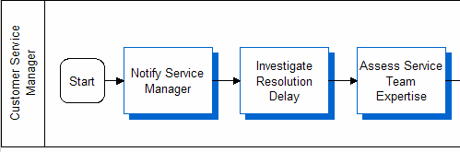
Automated Steps in Business Processes
A business process diagram is a way to represent and communicate a business process
  A business process is not a Workflow process
Workflow is used to automate steps in a business process
  A business process diagram may include steps that accomplish a task using automation
Automatically send email to notify Service Manager
Notes:
Business process diagrams are simply that: diagrams. These diagrams represent the way work is done in an organization. In this diagram shown on this slide, these steps are performed by a customer service manager. In the first step, Notify Service Manager, automation could be used to automatically notify the service manager by email.
Workflow and Assignment Manager are tools used to automate steps in a business process. Other examples of automation are:
Assign new service requests based on area (software, network, installation, upgrade, and so forth)
Send an email to the customer upon order confirmation, and
When a service request is not assigned it within 24 hours, send email notification to the manager

Slide 5
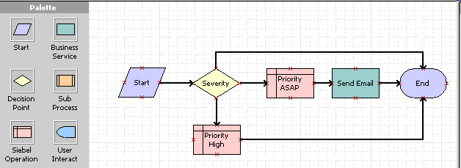
Workflow Process
Is an ordered set of steps executed in response to a defined set of conditions
Siebel Workflow provides:
  A set of tools to graphically define business processes
  An engine to automate these processes
Notes:
In Siebel 7.7, the Business Process Designer has been moved to Siebel Tools. While your students may not have exposure to previous versions of Siebel, as an instructor, you might want to understand the benefits of this move. As Workflow configuration is primarily a developer rather than administrator responsibility, it makes sense to include Siebel Workflow in the environment, Siebel Tools, that developers use. With Workflow in Siebel Tools, there is a single platform for configuring business processes and dependent objects. Developers can also take advantage of the Check-in/Check-out capabilities in Siebel Tools for their Workflow development.
Workflow processes allow users to define their company’s business processes using a familiar flowchart interface. They can define a process that includes subprocesses, decision points, and tasks. A task can be predefined or custom. Predefined tasks include updates to the Siebel database, notifications (such as an email or page), integration messages to external systems, and calls to invoke server tasks.
This workflow diagram shows that the Priority field in a Service Request can be updated based on the value in the Severity field, and in cases where priority is critical, an email is sent automatically.
More Examples:
When a Gold-level customer reports a high-severity problem, escalate the request if it is not addressed within one hour
When a critical service request is opened, page a field service agent
When a high-quality lead is created, send an email notification to the sales team

Slide 6
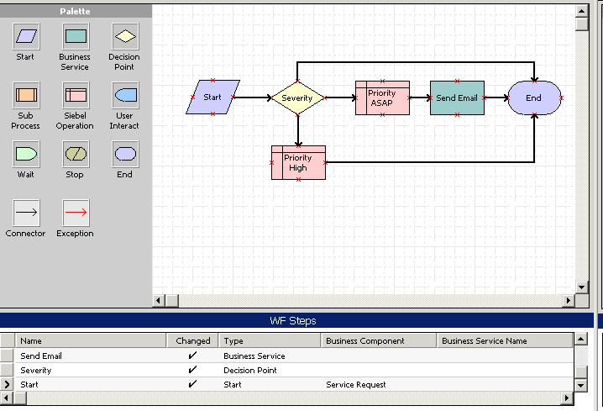
Workflow Design Canvas
Contains a palette, workspace, and detail applet
Palette of Workflow steps
Workspace for designing Workflows
Workflow detail applet
Notes:
The Workflow Design Canvas includes a palette of the various types of workflow steps, a workspace for designing workflow processes and a process detail apple. Later in this module you will learn how this applet is toggled to display different information about the process. In this screenshot, the detail applet is showing the process properties.

Slide 7
Workflow Process Automates a Business Task
Decide what business task the Workflow will automate
Assess the tasks that the workflow needs to complete to identify the activities that will need to be included in the process
  Check Severity field value
  Update Priority field value
  Send email
Check SR Severity
Update the Priority field in a Service Request based on the value in the Severity field, and in cases where priority is critical, automatically send an email.
Notes:
This is the first slide that presents a workflow example, Check SR Severity, that will be used throughout the remainder of the module. Emphasize that requirements are typically stated not a specific workflow definition that needs to be created, but more as a business need that requires automation. It will be up to the workflow developer to determine, from the business requirement, the various activities that the workflow process will need to accomplish.
In this slide, read the example, then work with the students to demonstrate how the three bullets at the bottom of the slide represent tasks the workflow process will perform.

Slide 8
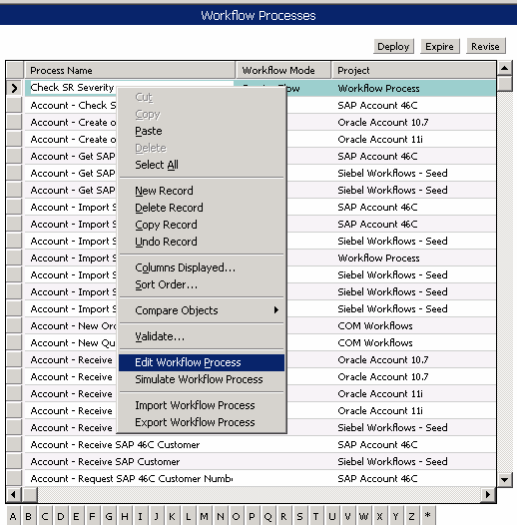
Workflow Process Definition
Start Siebel Tools
Check out project
Create a new workflow definition using List Editor
  Right-click OBLE and select New record
  Process Name and Project name are required fields
Edit workflow
  Right-click a workflow
  definition record and
  select Edit Workflow
  Process
Edit workflow process
Notes:
Once Siebel Workflow has been determined as the solution for a requirement, and the tasks for the workflow have been identified, creating the workflow process is as simple as creating a new record in Siebel Tools.
The Process Name and Project are required fields. To edit the Workflow, right-click the record and select Edit Workflow Process.

Slide 9
Select Workflow Steps
0/4
Start, End
Decision Point
Siebel Operation
Business Service
Notes:
This is a positioning slide. The following slides demonstrate the process of building a simple workflow.

Slide 10
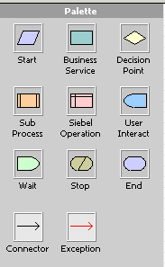
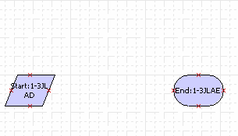
Start, End
1/4
Drag Start and End steps from Pallet to the Workspace
  Every Workflow process must have Start and End steps
  End step cleans up memory instances created during the Workflow process
Notes:
The Start step identifies the input conditions to be met in order for a process to execute. The End step specifies when a process instance is finished. At this point in the module, it is not necessary to provide all the detail about configuring Start and End steps, however, additional detail is provided below for your reference.
Start Step: A Start step is similar to a Decision step, in that you can define branches. The main parts of defining Start steps for a workflow process are:
Define the Start step
Define the Start step branches, conditions, and values
A Start step defines the process start condition. For example, to handle open service requests, users could define a start condition of Status = Open. They can define a condition on a Start step, but it is also recommended to have a default branch as well, to take care of conditions that are not specified. It might be misleading to have just a branch that has condition Status = Open. If the status is not equal to Open, then the process has nowhere to go. Users would perhaps want a default branch to go to an End step. Or, they might just specify one branch in the Start step, which would be the default branch.
End Step: The End step provides one last chance to store output arguments to a process property. Users can store output as process properties, but that is only useful if the End step is in a subprocess, and you want to pass the properties to the parent process. It is important to note that the process properties will disappear when the process ends. Each workflow process definition must have at least one End step.

Slide 11


Decision Point
2/4
Decision step is used to branch to various steps based on conditions
  Use a value comparison to determine which path to take
  Conditions are set once the next steps and branches are added
Check Severity Field Value
Notes:
The basic function of a Decision step is to provide branching within a workflow process based on defined conditions. Use this slide simply to introduce the concept of a Decision step; more detail is provided later in the module about defining conditions.
Emphasize that you should first build out the workflow steps, then go back and define any step details, including condition criteria.

Slide 12
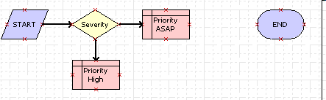
Siebel Operation
3/4
Used to perform insert, update, or query
Update Priority Field Value
Update Priority Field Value
Notes:
Continuing with the Check SR Severity example presented earlier, this slide introduces the Siebel Operation step. Again, emphasize building out the workflow before showing how details are defined for a Siebel Operation step. This information is provided later in the module.

Slide 13
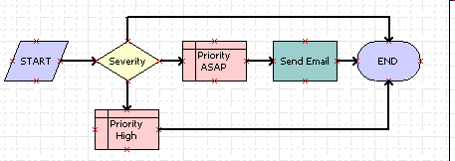
Business Service
4/4
Used to run a Siebel-supplied or custom business
service
Send Email
Notes:
To help define the Business Service step, provide examples of pre-defined business services:
Notifications: Notifications can be sent to employees or contacts using the Outbound Communication Server business service.
Assignment: Assignment Manager can assign an object in a workflow process by calling the Synchronous Assignment Manager Request business service.
Server tasks: A server component task can be run using the Asynchronous or Synchronous Server Requests business service.
Customers can also define custom business services in Siebel Tools that reflect the needs of their company. For example, they might have a specific forecasting algorithm that can be included as a step in their workflow process. Business services extend the standard functionality provided by workflow.

Slide 14
Defining Workflow Details
0/5
Context Sensitive Menus
Process Properties
Composing Condition Criteria
Siebel Operation Details
Business Service Details
Notes:
This is a positioning slide. The following slides show how to provide details for different types of workflow steps to complete a workflow process.

Slide 15
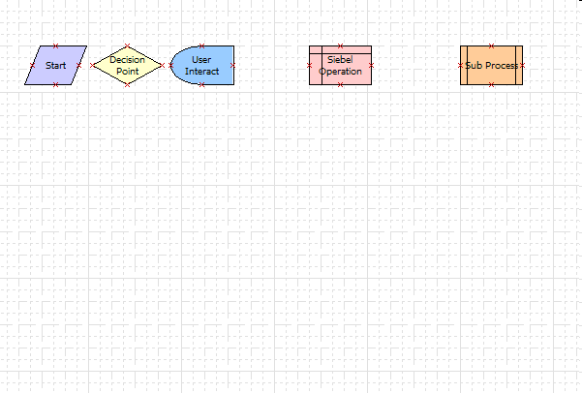
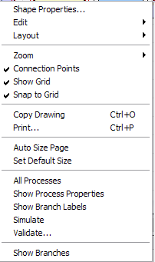
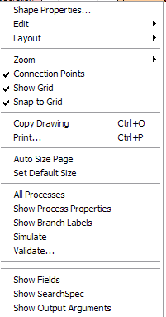
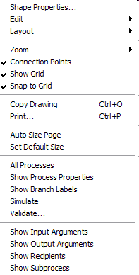
Context Sensitive Menus
1/5
Use right-click to access menu options for different type of steps
  Toggles the information displayed in the Workflow detail applet
Notes:
For most steps, adding additional detail for the step is done through the context-sensitive menu. In the bottom-most section in each of these menus, the options in the menu vary for the different types of steps.
For the Start, Decision, and User Interact steps, selecting Show Branches in the context menu will display any branches leading to or from the step in the detail applet. Similarly, you can select Show Fields, Show SearcSpec, and Show Output Arguments for a Siebel Operation step. With a Sub Process step, the options are Show Input Arguments, Show Output Arguments, Show Recipients and Show Subprocess.

Slide 16
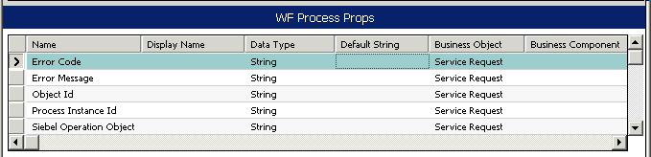
Process Properties
2/5
Used as input and output arguments for the entire process
  Process Properties are referenced as Input Arguments and Output Arguments for steps in the process
Commonly used to set Row ID for a test record
Context-sensitive menu options for Sub Process step
Notes:
As they learn to develop and test workflow processes, the process property students will become most familiar with is the Default String for Object ID. This property holds the Row ID for a test record.
However, process properties are used in a broader sense to store values that the workflow process retrieves from the database or derives before or during processing. Decision branches can use the values in a process property and pass process properties as step arguments. When a workflow process completes, the final results of the process properties are available as output arguments. You can also use process property values in expressions.
The student note provides explanations of predefined process properties.

Slide 17
Composing Condition Criteria
3/5
Set conditions for any step that can have multiple branches
  Start Step
  Decision Step
  User Interact Step
Conditions are defined on
branches leading from the step
Right-click branch and select Edit Conditions
Select Show Branches to see all branches
Notes:
As most instructors are familiar with previous version of Siebel Workflow, it is important to note that entering conditions has changed significantly for Siebel 7.7. In previous versions, you would double-click the step, then edit the Next Steps list. In the Business Process Designer for Siebel 7.7, you edit the branch itself. You can either right-click a branch and select Edit Conditions, or you can double-click the branch to open the Compose Condition Criteria window (covered in the next slide).

Slide 18
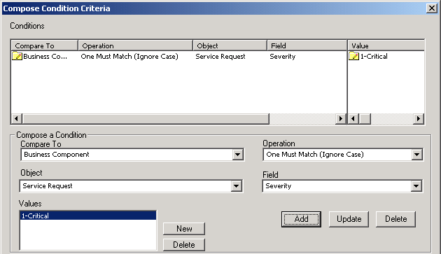
Composing Condition Criteria Continued
3/5
Set condition criteria
  Example: Follow this branch if Severity field from the Service Request object matches the value 1-Critical
Notes:
In this screenshot, the branch that leads from the Severity decision step to the Priority ASAP Siebel operation step has a condition that states that the Severity field in the Service Request business component must much the value of 2-High. Once you have composed the condition, click the Add button to add it to the list of conditions at the top. This is a frequent mistake that developers make: forgetting to click the Add button. An important reminder … make sure to click the Add button during the labs.

Slide 19

Siebel Operation Details
4/5
Select the field to be updated and set the new value
Right-click branch and select Show Fields
Notes:
Defining the fields to insert, update, or query in a Siebel Operation step has changed significantly for Siebel 77. Instructors new to this version should see that to set fields, right-click the Siebel Operation step and select Show Fields. This changes the detail applet to Input Arguments. Create new records in the Input Arguments list as needed to complete the Siebel Operation step definition.

Slide 20
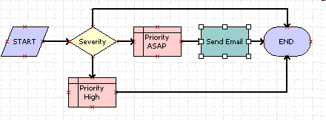
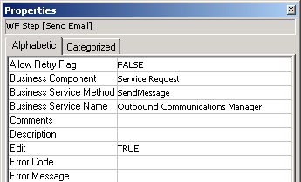
Business Service Details
5/5
Set Business Service Name and Business Service Method in the Process Properties window
  To specify additional details, right-click the Business Service step and select Show Input Arguments
Set Business Service Name and Method
Notes:
One other significant change in workflow for Siebel 7.7 is the use of the Properties window in Siebel Tools to set Business Service Name and Business Service Method. Additional details for a Business Service Step are defined by selecting Show Input Arguments from the step's context-sensitive menu.

Slide 21
Additional Workflow Steps
0/4
Error Handling
Sub Process
Wait Step
User Interact
Notes:
This is a positioning slide. The following slides complete the discussion of types of workflow steps by describing steps that were not included in the Check SR Severity example.

Slide 22


Error Handling
1/4
Exception
  Use it to handle system and user-defined errors
  Define exception conditions just as you would define other branch conditions
  Example: If email error, update error report
Use Stop to raise an exception
  Notifies user of error and stops workflow process instance
Notes:
An exception represents a deviation from normal processing. An exception can be a system error or a user-defined error.
The Stop step is used to notify the user of an error and terminate the workflow process instance. The main parts of creating a Stop step for a workflow process are:
Define a Stop step
Define input arguments for the Stop step

Slide 23


Sub Process
2/4
Use it to invoke another process within an existing workflow process
  Reuse previously defined workflow processes
Invokes another workflow process
Notes:
Subprocesses allow developers to reuse a previously defined workflow process as a step in another workflow.
A Sub Process step allows users to invoke an entirely separate process within a process. To create a subprocess, users must define:
A Sub Process step
Input arguments for the subprocess
Output arguments for the subprocess
In the module on Understanding Interactive and Long-Running Flows, students will see how a sub process can be used in a Long-Running Flow, and how the entire subprocess can be assigned using the Show Recipients option in the context-sensitive menu.

Slide 24


Wait Step
3/4
Use it to define a period of time before executing a subsequent process
Example: If SR not assigned within one day, send email to manager
Notes:
Wait steps allow suspension of process execution for a specific period of time. Here are some examples:
On day one of a campaign, send an email. On day two of the campaign, send another email.
If a high-quality lead has not been updated within five business days, escalate to a manager.

Slide 25


User Interact
4/4
Navigates user to a view and waits for a response
Example: Navigates user to Standard Payment View to enter credit card number before purchasing items in shopping cart
Notes:
The User Interact step enables the application to display a specific view, and then require the user to enter a value before continuing to the next view. More about the User Interact step will be in the module on Understanding Interactive and Long-Running Flows.

Slide 26
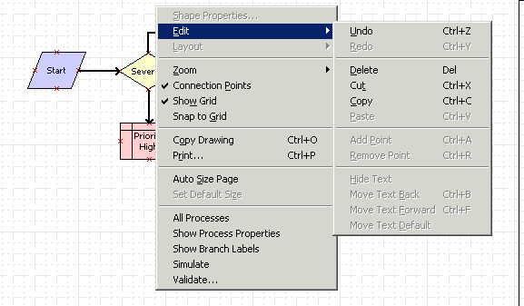
Using Editing Features
Copy, paste, delete
  Limited to within the
  design canvas
  Cannot copy across
  processes
Copy drawing
Print
Edit graphical properties
  Color, size, lines
Zoom
Align Objects
Notes:
A wide range of options for editing are available in the Context-Sensitive menu that appears when you right-click the design workspace. You can copy and paste boxes within a single workflow, but note that you can only copy and paste within a single processes and not between process diagrams. You can also change the color, size, and line format for any object in a Workflow process diagram; or zoom out to better view the process diagram. There are also drawing aids such as Align Objects and Snap to Grid.
You may find it easier to align connectors between steps if they uncheck Snap to Grid.

Slide 27

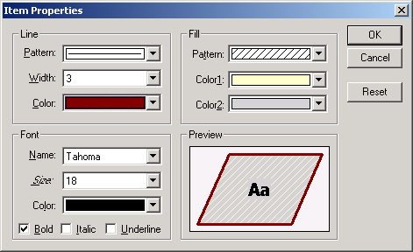


Using Shape Properties
Define shape colors, lines, fill properties, fonts and sizes
Resize shapes as needed
Notes:
Right-click any step in the Workflow process diagram to edit its shape properties. The Item Properties dialog box has editing options very similar to those you would see in most standard desktop applications. You can apply patterns to the lines or fill; change the color of the line, fill, or text; control the width of the line and the size of the text; and use bold, italic, or underline formatting for the text. Once you have made any changes to a shape, you can resize the shape if needed to accommodate larger text.

Slide 28
Summary
This module showed you how to:
  Describe the different steps of a Workflow process
  Create a Workflow process in Siebel Tools
Notes:
Review Question: What is the difference between a business process and a workflow process?
Answer: A business process is a diagram of how work gets done in an organization. A workflow process automates a specific task or set of tasks that are depicted by a business process. A business process by itself has no functionality. A workflow process can be used to implement portions (automated portions) of a business process.
Review Question: When would you use a Siebel Operation step?
Answer: A Siebel Operation step is used whenever a value needs to be inserted or updated in the database, or when a query for a value needs to be performed inside a workflow process.
Review Question: How are condition criteria composed for a Decision or Start step?
Answer: Right-click the branch following the step. Specify the comparison type (usually business component), object, operation, field, and value. Click the Add button to save the criteria.

Slide 29
Lab
In the lab you will:
  Create a workflow process that can be used to create an activity for an account
  Create conditions in a workflow process to control when the process is executed
Notes:
See lab instructions for details.
Labs and Troubleshooting:
Lab 39-2: Adding points to connector steps can be a bit tricky, so be prepared to assist students if they need help.
Please note: There is not a solution document for lab 39-1.

